Slide 1


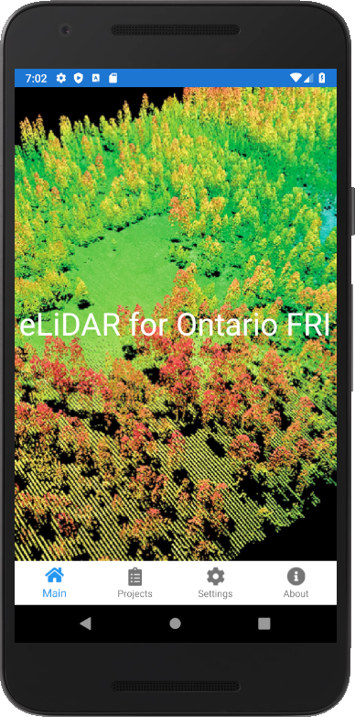
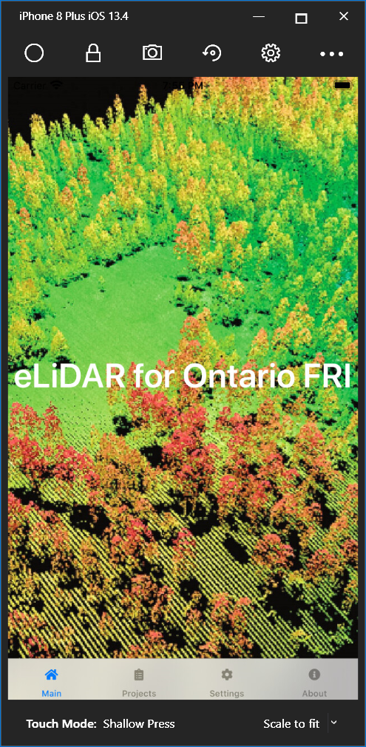

Presentation for KTTD 6A-2018
eFRI Next Generation Ground Data Handhelds
Craig Robinson, RPF
Notes:
Difficult to collect complex data
Difficult to collect data in long lists

Slide 2

Overview
A bit of a history of Ground Data Collection Apps
The other current technologies for mobile data collection
The technology we chose to go with
A brief tour of the app
Next steps
Notes:
How can we integrate the operational piece to inform the strategic LTMD?

Slide 3
But first….
Notes:
Talk about polygon as basic spatial feature
Not just a table of numbers
Since it is polygon-based, spatial, have awareness of proximity to other features

Slide 4
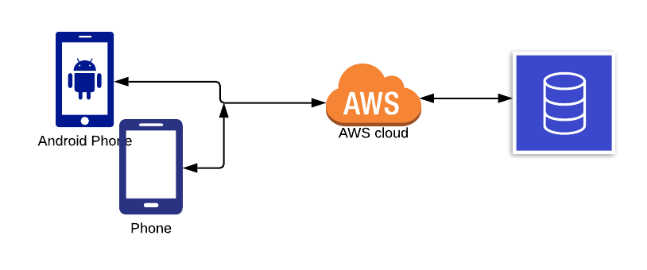
Connected Apps
Notes:
Highlight that the app functions can exist on a server
In forestry – this type of app does not work – yet
Facebook, or instagram is an example of a connected app

Slide 5
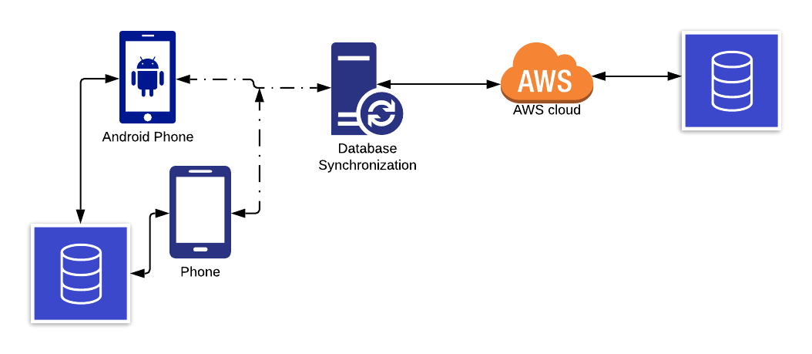
Disconnected Apps
Notes:
All of the functions exist on the app
A database
Synch feature just synch’s data when connected
Survey123 is a disconnected app

Slide 6
A bit of history
Notes:
Talk about polygon as basic spatial feature
Not just a table of numbers
Since it is polygon-based, spatial, have awareness of proximity to other features

Slide 7
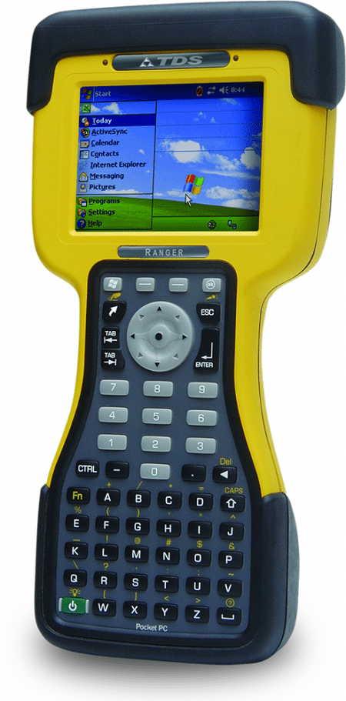
Windows Mobile
Some differences from non-spatial models:
  Each polygon in forest is tracked and described by growth, yield and management characteristics over time
  Polygons have relationships to one another to consider patches, edge, adjacency relationships along with other management objectives
  Model simulation results in a spatial harvest allocation that meets management objectives
Very rugged
Not really connected devices
Windows Mobile support ended a long time ago
Morphed into other products – like Windows Phone – that never took off
Build apps in .NET Compact Framework
Notes:
Disdvantages
No longer supported
Interfaces were tough to use and design
Became the purview of professional, surveying apps
Actually still available
.

Slide 8
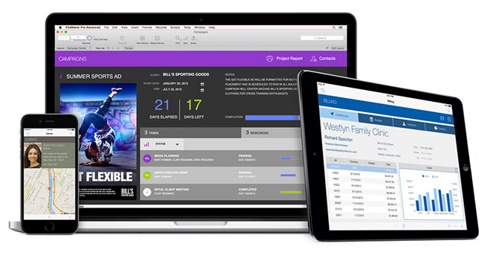
FileMaker Pro / Go
Some differences from non-spatial models:
  Each polygon in forest is tracked and described by growth, yield and management characteristics over time
  Polygons have relationships to one another to consider patches, edge, adjacency relationships along with other management objectives
  Model simulation results in a spatial harvest allocation that meets management objectives
Easyish development
Deploy to iOS devices
Works disconnected
Challenging scripting language
Takes some effort to retrieve data
Notes:
GIS-based
How to use spatial relationships: patches to get the right size openings, roads to cluster harvest, mills to balance allocation and haul costs
.

Slide 9
More Modern Solutions
Notes:
Talk about polygon as basic spatial feature
Not just a table of numbers
Since it is polygon-based, spatial, have awareness of proximity to other features

Slide 10

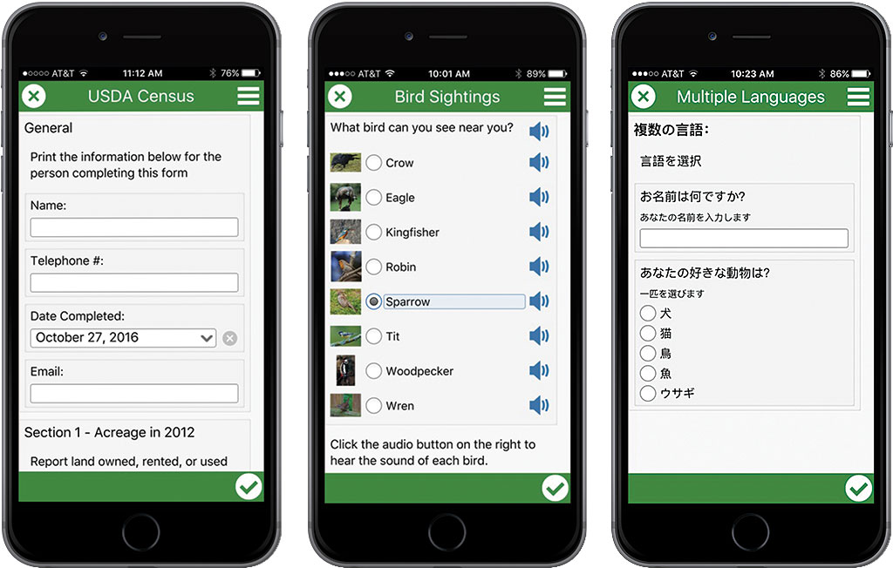
Survey 123 (from Esri)
Some differences from non-spatial models:
  Each polygon in forest is tracked and described by growth, yield and management characteristics over time
  Polygons have relationships to one another to consider patches, edge, adjacency relationships along with other management objectives
  Model simulation results in a spatial harvest allocation that meets management objectives
Very configurable
Works disconnected
Integrated with GIS
Deploys to iOS, Android
TOO Simple!
Notes:
GIS-based
How to use spatial relationships: patches to get the right size openings, roads to cluster harvest, mills to balance allocation and haul costs
.

Slide 11
The Problem
10 prism sweeps
2 ages and heights
A Soil and Ecosite
Notes:
Talk about polygon as basic spatial feature
Not just a table of numbers
Since it is polygon-based, spatial, have awareness of proximity to other features

Slide 12
Vegetation Sampling Network
ECOSITES
TREES
Add SMALL TREES
Add Understory Veg
SOILS
Add STEM MAPS
Add DWD

Slide 13




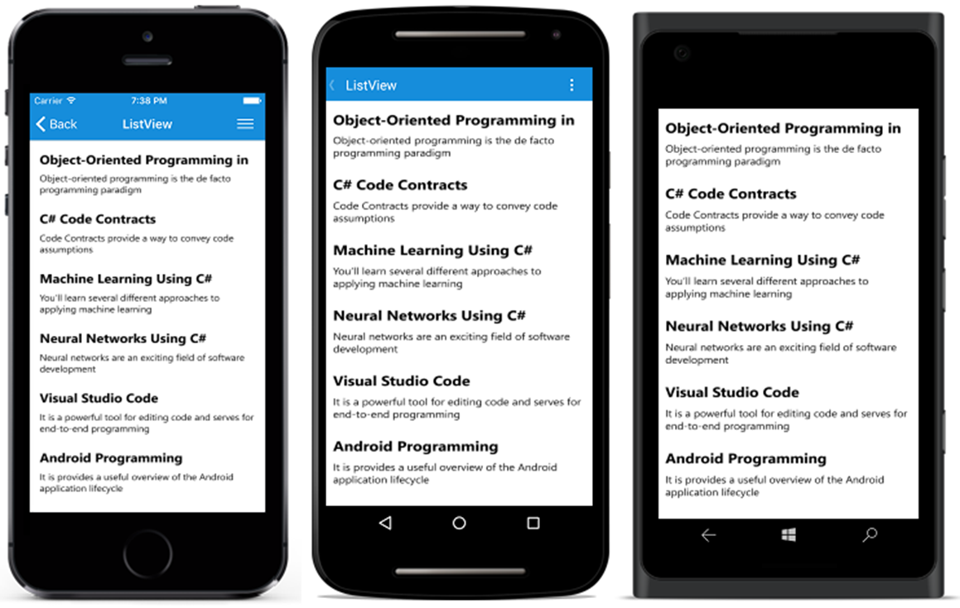
Xamarin Forms
Some differences from non-spatial models:
  Each polygon in forest is tracked and described by growth, yield and management characteristics over time
  Polygons have relationships to one another to consider patches, edge, adjacency relationships along with other management objectives
  Model simulation results in a spatial harvest allocation that meets management objectives
Cross-Platform
Develop in C# and XAML
One set of code
Deploy to iOS, Android, UWP devices
Ability to have the app be whatever you want
Notes:
GIS-based
How to use spatial relationships: patches to get the right size openings, roads to cluster harvest, mills to balance allocation and haul costs
.

Slide 14
What did we do?
Notes:
Talk about polygon as basic spatial feature
Not just a table of numbers
Since it is polygon-based, spatial, have awareness of proximity to other features

Slide 15
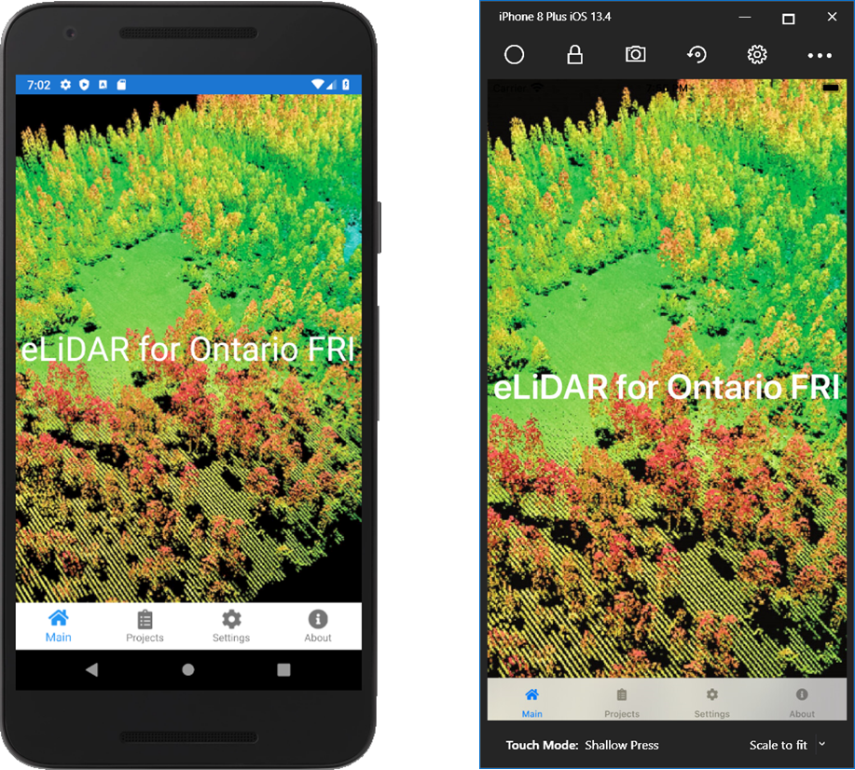
eLiDAR
Some differences from non-spatial models:
  Each polygon in forest is tracked and described by growth, yield and management characteristics over time
  Polygons have relationships to one another to consider patches, edge, adjacency relationships along with other management objectives
  Model simulation results in a spatial harvest allocation that meets management objectives
Built in Xamarin.Forms, C#, SQLite and Azure SQL
Deployable to iOS 13+ or Android 9+
Works fully disconnected
Collects data for Plot Types A, B, C
Multi-device/multi-user
Notes:
GIS-based
How to use spatial relationships: patches to get the right size openings, roads to cluster harvest, mills to balance allocation and haul costs
.

Slide 16
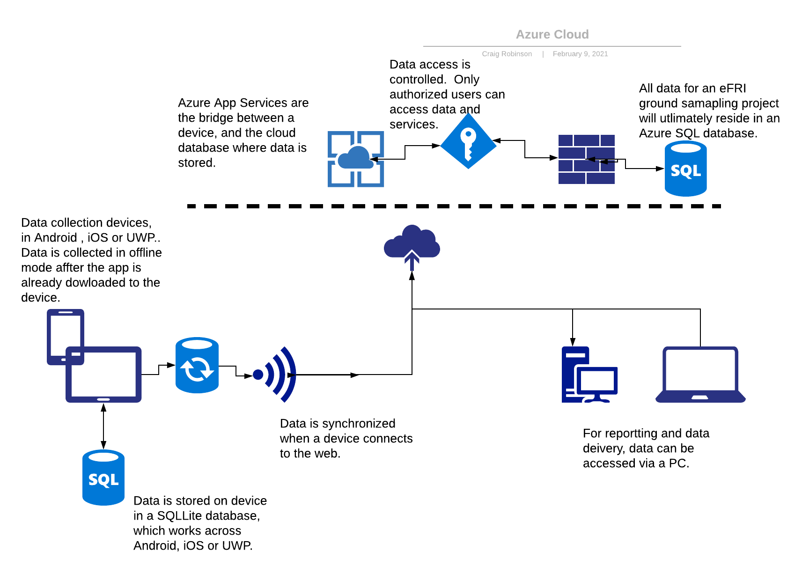

Slide 17
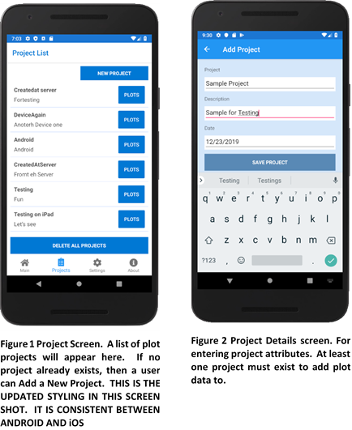
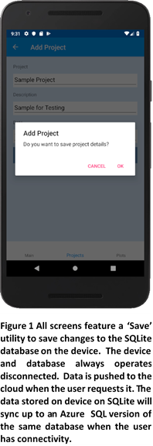
Common App Patterns
Some differences from non-spatial models:
  Each polygon in forest is tracked and described by growth, yield and management characteristics over time
  Polygons have relationships to one another to consider patches, edge, adjacency relationships along with other management objectives
  Model simulation results in a spatial harvest allocation that meets management objectives
Lists
Details
Add Buttons
Notes:
GIS-based
How to use spatial relationships: patches to get the right size openings, roads to cluster harvest, mills to balance allocation and haul costs
.

Slide 18
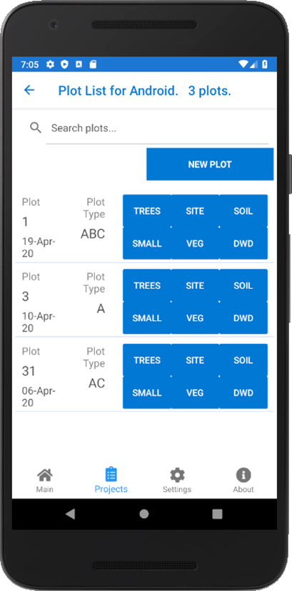
Multi-Device
Some differences from non-spatial models:
  Each polygon in forest is tracked and described by growth, yield and management characteristics over time
  Polygons have relationships to one another to consider patches, edge, adjacency relationships along with other management objectives
  Model simulation results in a spatial harvest allocation that meets management objectives
More than one device in a plot
Notes:
GIS-based
How to use spatial relationships: patches to get the right size openings, roads to cluster harvest, mills to balance allocation and haul costs
.

Slide 19
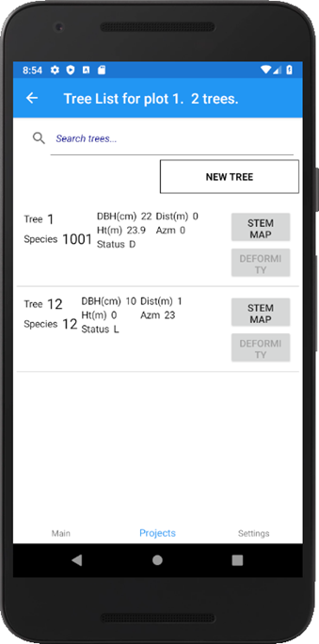
Understands Plot Types
Some differences from non-spatial models:
  Each polygon in forest is tracked and described by growth, yield and management characteristics over time
  Polygons have relationships to one another to consider patches, edge, adjacency relationships along with other management objectives
  Model simulation results in a spatial harvest allocation that meets management objectives
Only let you enter the screens associated with the plot type
Notes:
GIS-based
How to use spatial relationships: patches to get the right size openings, roads to cluster harvest, mills to balance allocation and haul costs
.

Slide 20
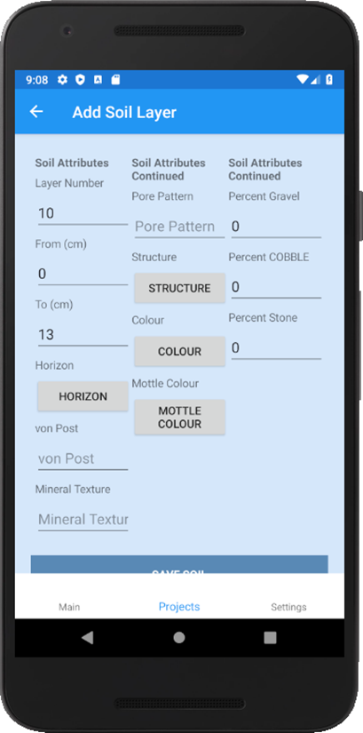
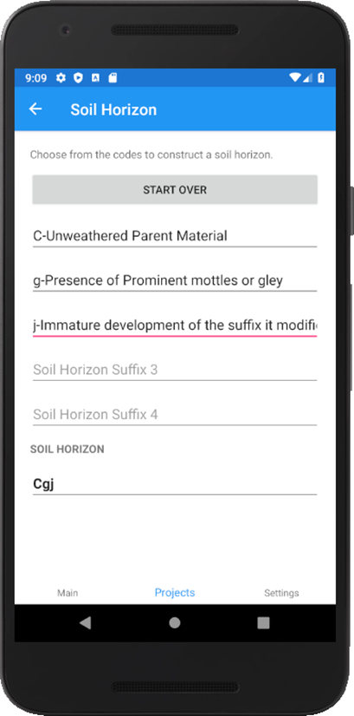
Helpers
Complex Types
Some differences from non-spatial models:
  Each polygon in forest is tracked and described by growth, yield and management characteristics over time
  Polygons have relationships to one another to consider patches, edge, adjacency relationships along with other management objectives
  Model simulation results in a spatial harvest allocation that meets management objectives
Soil Horizons
Ecosites
Notes:
GIS-based
How to use spatial relationships: patches to get the right size openings, roads to cluster harvest, mills to balance allocation and haul costs
.

Slide 21
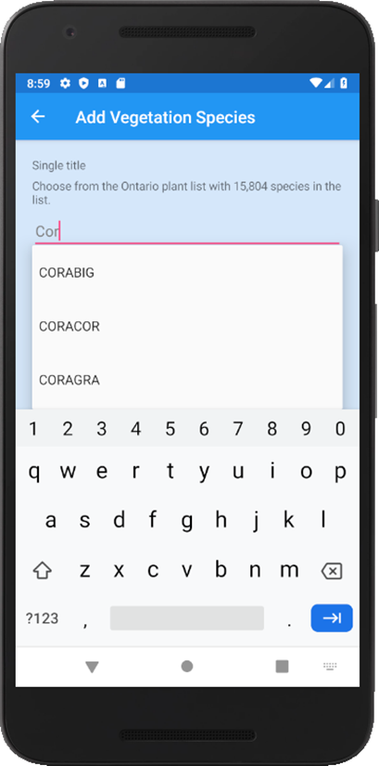
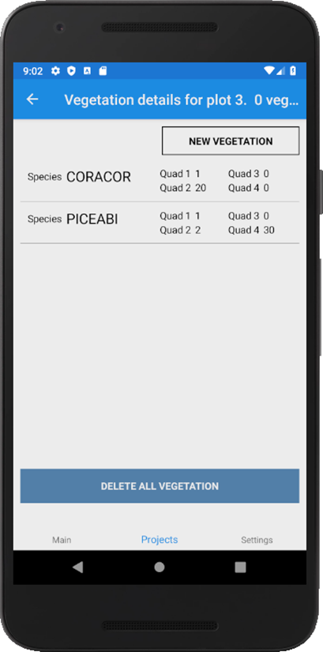
Helpers
Really Big Lists
Some differences from non-spatial models:
  Each polygon in forest is tracked and described by growth, yield and management characteristics over time
  Polygons have relationships to one another to consider patches, edge, adjacency relationships along with other management objectives
  Model simulation results in a spatial harvest allocation that meets management objectives
Over 15,000 understory species in the understory vegetation plot
Notes:
GIS-based
How to use spatial relationships: patches to get the right size openings, roads to cluster harvest, mills to balance allocation and haul costs
.

Slide 22
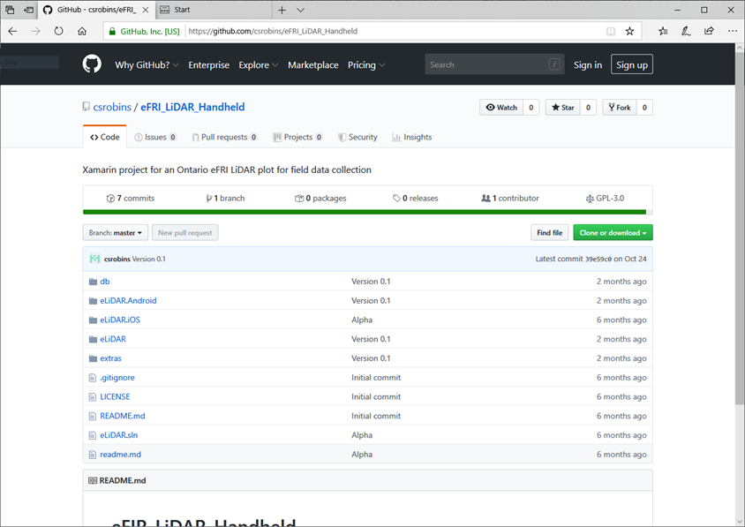
Github
Some differences from non-spatial models:
  Each polygon in forest is tracked and described by growth, yield and management characteristics over time
  Polygons have relationships to one another to consider patches, edge, adjacency relationships along with other management objectives
  Model simulation results in a spatial harvest allocation that meets management objectives
Open Source!!!
Links in the online report
Notes:
GIS-based
How to use spatial relationships: patches to get the right size openings, roads to cluster harvest, mills to balance allocation and haul costs
.

Slide 23
Next Steps
Notes:
Talk about polygon as basic spatial feature
Not just a table of numbers
Since it is polygon-based, spatial, have awareness of proximity to other features

Slide 24
Next Steps
Notes:
Talk about polygon as basic spatial feature
Not just a table of numbers
Since it is polygon-based, spatial, have awareness of proximity to other features

Slide 25
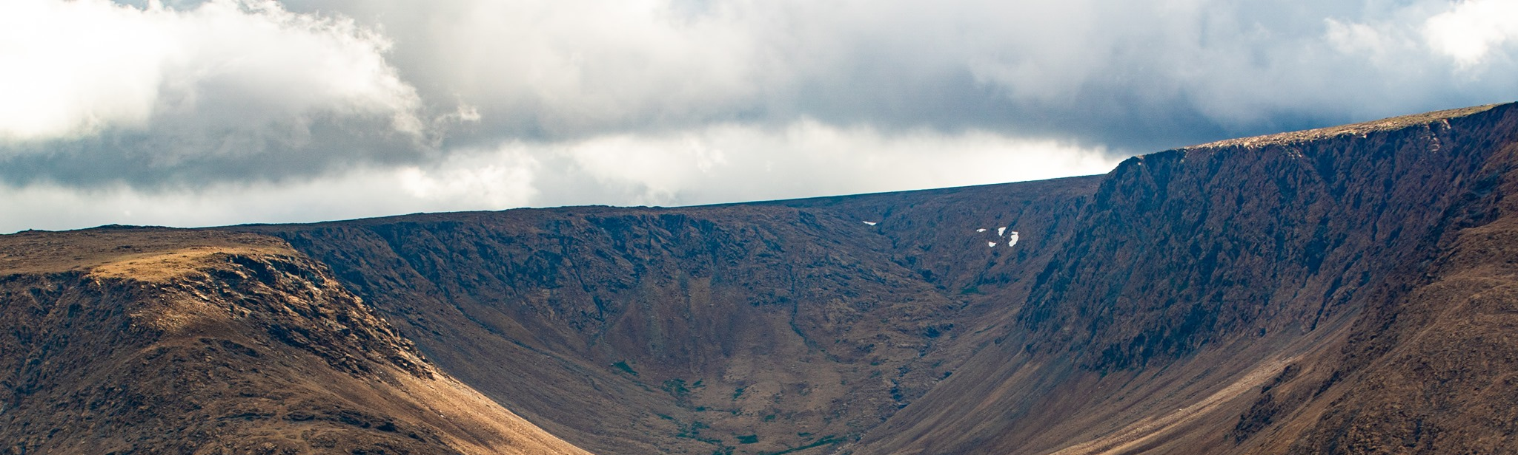

Questions?
Craig Robinson, RPF
Senior Forest Analyst
Ontario
crobinson@forsite.ca
519-635-4500

