Slide 1
A Review, Enhancement and Accuracy Assessment of Wetland Inventory Features in Quetico Park
Keith Hautala (Confederation College, Thunder Bay)
Dave Thomson (Thomson Environmental) • Allan G. Harris (Northern Bioscience) • Sebastian Blemar-Lucero • Alain Richard (Ducks Unlimited) • Ashley Thomson (Lakehead University)
February 25th, 2021
Forestry Futures Trust Committee KTTD Round 2 Technology Transfer Presentations

Slide 2
Outline
Background/Rationale
Scope/Methods
Results
Field
Photointerpretation: Examples and Overall Results
Comparison to Field Data
Machine learning/CNN

Slide 3
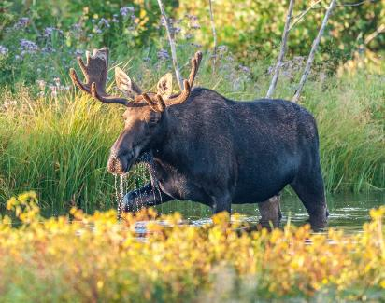
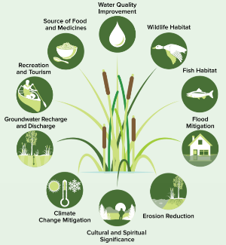
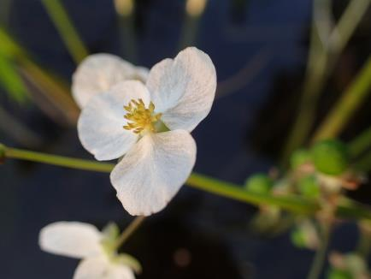
Background and Problem Statement
Accurate wetland inventories and an enhanced understanding of wetland habitat supply is increasingly important in meeting the growing requirements of fish and wildlife management, the Species at Risk and Migratory Birds Acts, forest certification standards, etc.
Kevin Noble
Al Harris
OMNRF (2017). A Wetland Conservation Strategy for Ontario 2017–2030

Slide 4
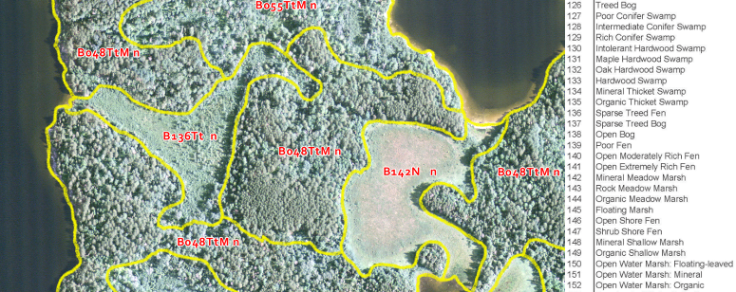
Background and Problem Statement
The Ontario ecological land classification system includes 35 wetland ecosites, but the eFRI inventory process omits most wetlands lying within the boundary of waterbodies as well as small islands.
For example, the Quetico Park inventory has little area identified as shore fens and no area in shallow or open water marshes -- despite these wetland ecosites certainly existing in the field

Slide 5
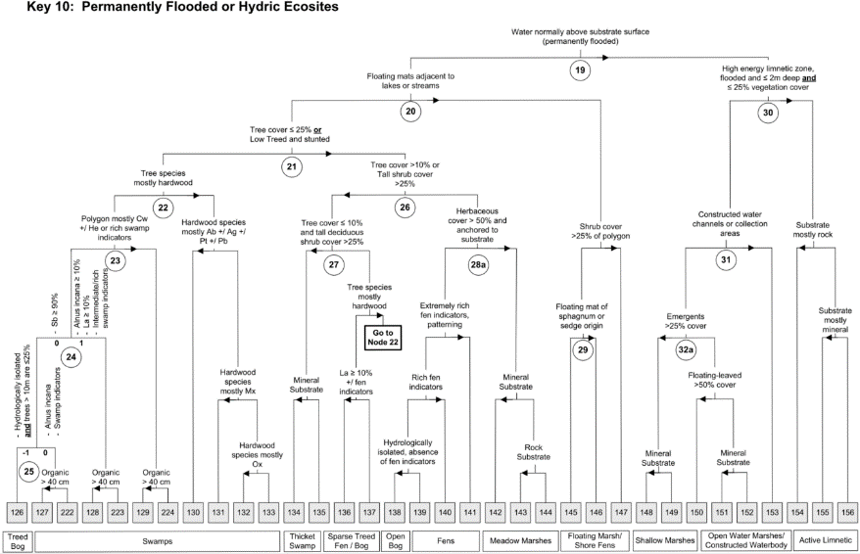
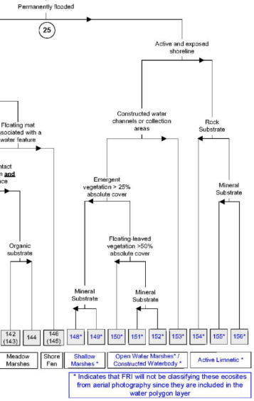
Background and Problem Statement
Water is a ‘no go’ zone for FRI
Logical from the viewpoint of a forest inventory traditionally aimed at evaluating terrestrial values
Photo Interpretation Manual
Ecosite Manual

Slide 6
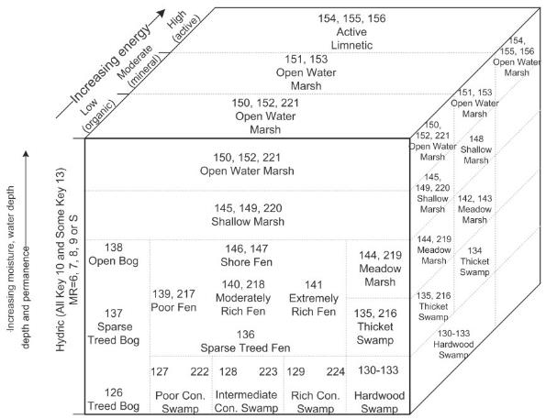
Scope and Methods
Quetico Park
Digital aerial imagery (ADS40) for lake and island polygons reviewed to assess areas omitted or incorrectly classified during the initial FRI creation
Field verification of a subsample of wetland polygons delineated during air photo interpretation. Used to produce an accuracy assessment of photo-interpreted ecosite call
Ducks Unlimited Canada to produce a cross-walk to their Enhanced Wetland Classification (EWC) system
Exploration of machine learning (convolutional neural networks) to automate classification

Slide 7
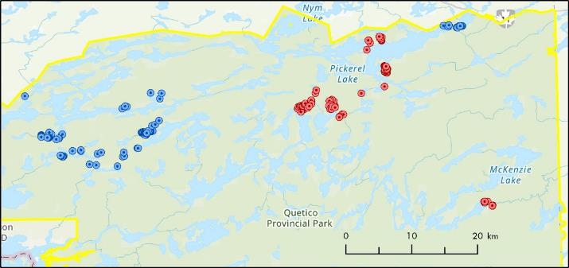
Results: Field Validation (mid-late August)
Plant species cover was estimated in a 5m x 5m quadrat
Vascular plant species and macroalgae occurring in the quadrat recorded and percent cover estimated
Surface water and substrate pH and conductivity recorded from three samples at each site
Water depth and dominant substrate measured near the centre of each quadrat
Ecosite and w-type were recorded for each plot
Fetch distance (m) and direction estimated following field work using GIS
167 locations
2018 = 85 (red)
2019 = 82 (blue)

Slide 8
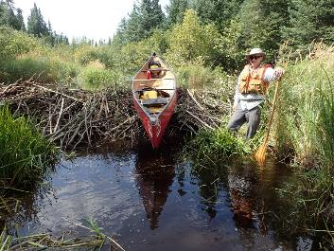
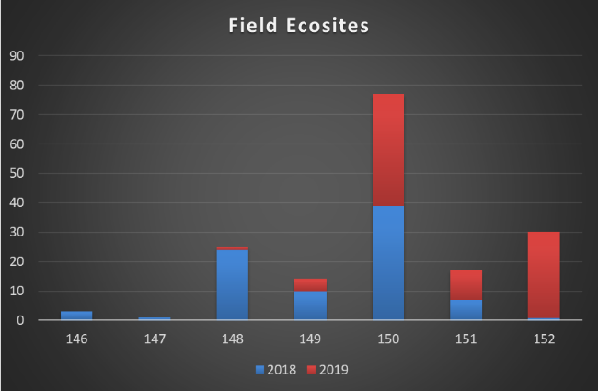
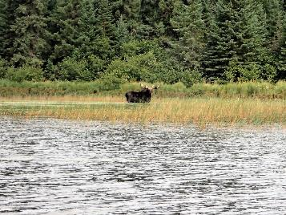
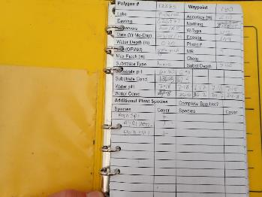
Results: Field Validation

Slide 9
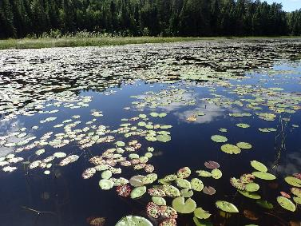
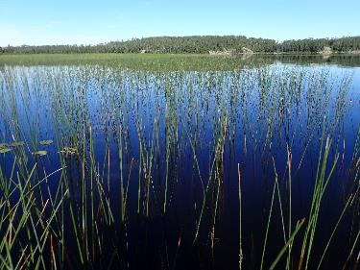
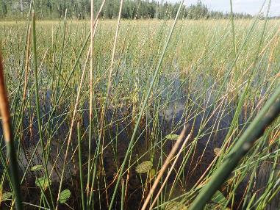
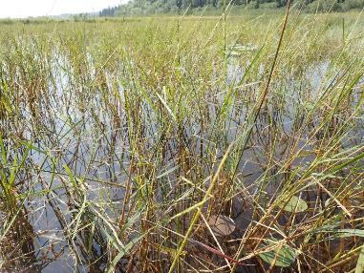
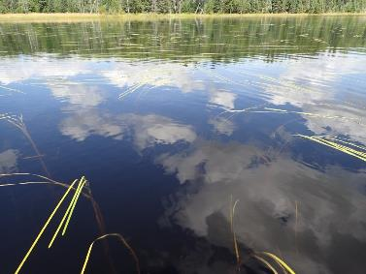
Results: Field Validation
Plot 31: 150 (Open Water Marsh: Floating-leaved)
Plot 1: 151 (Open Water Marsh: Mineral)
Plot 39: 148 (Mineral Shallow Marsh)
Plot 57: 149 (Organic Shallow Marsh)
Plot 42: 152 (Open Water Marsh: Organic)

Slide 10
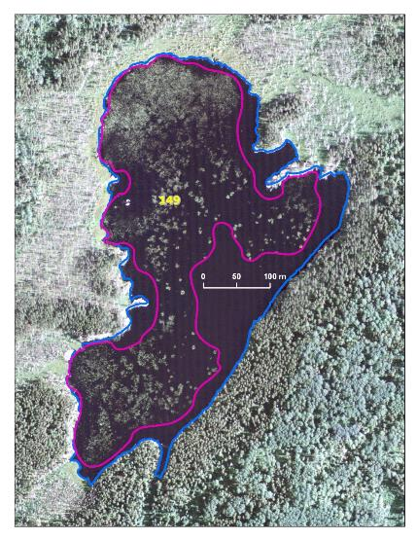
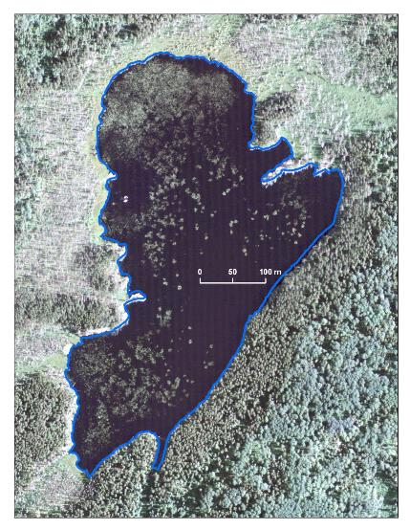
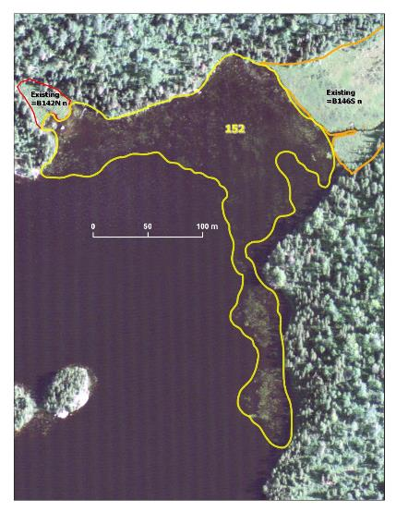
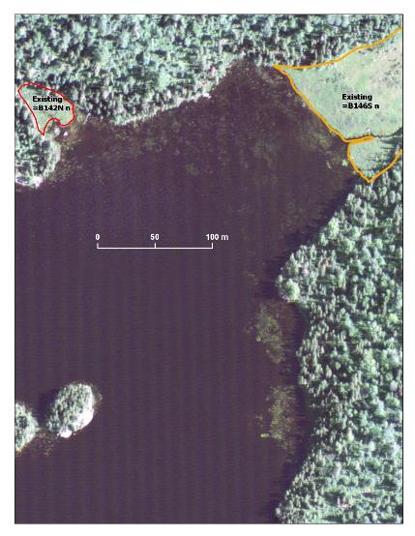
Results: Photo Interpretation

Slide 11
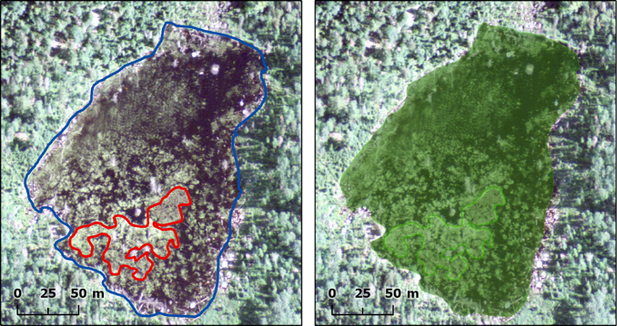
Results: Photo Interpretation
Example of a small island polygon (red outline, left image), within a water polygon (blue outline) in the original inventory. The image on the right shows both original polygons have been reclassified as wetland (Ecosite 144).

Slide 12
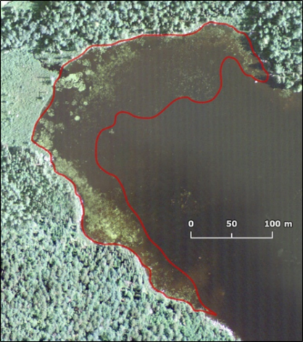
Results: Photo Interpretation
Wetland vegetation communities often occur in patterns that are highly variable, and at times are not independently mappable with efficiency
For example, a mosaic of emergent vegetation cover percentages along a shoreline
A primary and secondary ecosite approach was used during delineation to avoid numerous small polygons and produce a more efficient workflow
Minimum polygon size 500m²
A complex wetland polygon containing a mix of shallow marsh (149, primary Ecosite) and open water marsh (152, secondary Ecosite)

Slide 13
Results: Photo Interpretation
7,209 water polygons (108,437 ha) and 6,953 island polygons (2,148 ha) were reviewed for unidentified wetland ecosites
1,886 new wetland polygons for a total area of 2,607.6 ha
Organic Shallow Marsh (149, 54.3%) and Open Water Marsh: Organic (152, 28.2%)
Default rules
Secondary ecosites were applied to 494 (36%) of the polygons that were formerly water
Area best described as a complex ecosite composition
8.9% of waterbody polygons contained at least one wetland
7.1% of all island polygons reclassified, at least in part, as wetlands

Slide 14
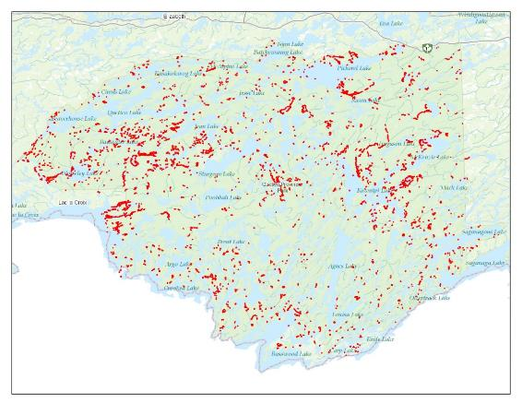
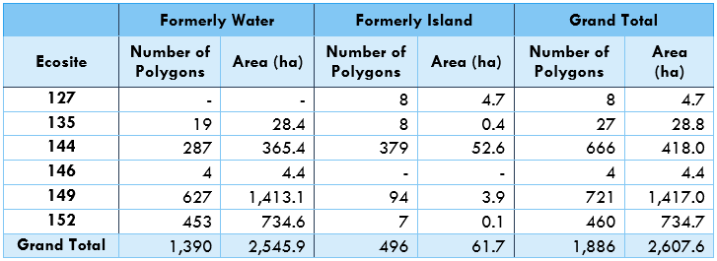
Results: Photo Interpretation
Represents a very small (~0.5% of entire area) but valuable piece of ecosystem data

Slide 15
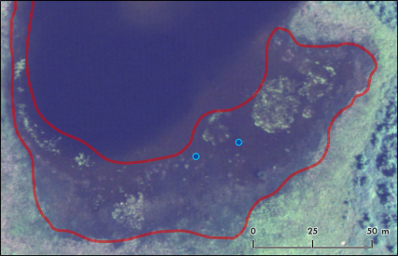
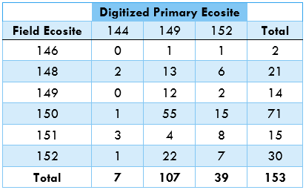
Results: Field vs. Photo
Challenges in ‘plot level’ versus ‘area or polygon level’ assessment
Annual and intra-annual conditions of field vs. photo date
Default classification rules were applied where ecosites are dependent on substrate type (e.g. 148 vs. 149, 151 vs. 152)
In situations where this level of detail is important for habitat or ecosystem evaluation the use of ADS imagery alone may be insufficient
Field sites (blue dots) were classed as open water marsh (152) within a complex wetland polygon (red outline). This polygon had a primary ecosite of shallow marsh (149) with a secondary ecosite of open water marsh (152).

Slide 16
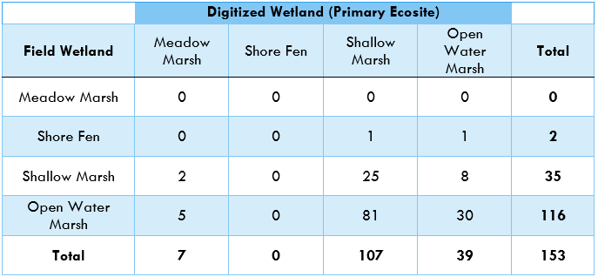
Results: Field vs. Photo
Consider management objectives/uses of inventory
148 and 149 are both shallow marshes
150, 151, and 152 are open water marshes
Shallow marshes identified in the field had general agreement with the digitized polygons (71% correct) as did digitized open water marshes in comparison to the field data (77% correct)
Of the 116 field sites that were classed as open water, 72 (62%) were in polygons that had open water marsh as either the primary or secondary ecosite

Slide 17
Results: Deep Learning Classification
The original project proposal did not include a deep learning component
Feasible to identify via manual photointerp illustrated, but labour intensive
Studies (Amani et. al. 2018, Mahdianpari, et. al. 2018) suggest the classification of wetlands using deep learning may outperform other methods (e.g. random forest)
A number of studies have investigated the use of convolutional neural networks and satellite imagery to identify wetlands in Canada at large spatial scales (Amani et. al. 2019, Pouliot et. al. 2019), but few studies have leveraged fine resolution imagery (Du et. al. 2020) and scales
All models were created in Tensorflow 2.1.0
Chips and models available

Slide 18
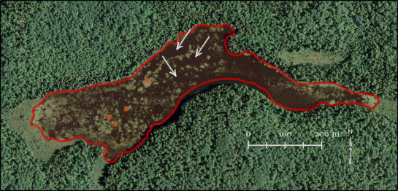
Results: Deep Learning Classification
Image chips of 32 x 32 pixels (~13m x 13m) were extracted from each of six different classes: water, terrestrial island (i.e. true island), ecosites 135, 144, 149 and 152
Ecosite146 was not included as there were only two polygons in this class within the study area
Image chips were created for both 3 band RGB and a 3 band false-colour (NIR, R, G) as these wavelengths are known to have strong predictive value for wetlands
1,000 chips per class (6,000 total) for training/validation with an additional 100/class (600) for test set
Image chip locations were manually selected within areas to ensure the sample area represented the class and were not overlapping boundaries of other classes
Example of image chip locations (orange squares) extracted from a wetland feature. White arrows indicate areas of intermixed open water which were avoided.

Slide 19
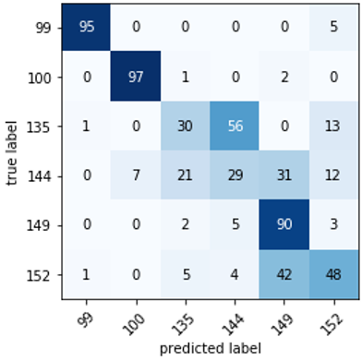
Results: Deep Learning Classification
Multiple architectures quickly investigated with nine models more fully explored
Final model produced a training and validation accuracy of 90.7% and 82.7% respectively at the end of 125 epochs
The model was then used to predict the 600 test images
Broad classes of water (label = 99), land (label = 100) and wetlands with accuracies of 95%, 97% and 98% respectively
Less accuracy at the ecosite level
Performed well on ecosite 149 (90%)
Frequently misclassified ecosites 135 (30% accuracy) and 144 (29% accuracy)
Limited number of polygons from which to choose from for the training set
If ecosite 152 (open water) was combined with 149 (shallow water), the model had a 90% accuracy in classifying these marsh types within the test data
Confusion matrix for test images [99 = water, 100 = land, and all other labels are wetland ecosites].

Slide 20
Conclusions
While the overall wetland area added to the inventory (~2,600 ha) is small compared to the landbase, it is important to note that much of this area is in ecosites that were completely omitted from original inventory procedures
Reasonable ability to identify wetland classes from the ADS imagery, but that some caution is needed as ecosite-specific determination remains difficult
Depending on the end use of the wetland inventory (i.e. if specific ecosites are required, or if broader classifications are sufficient) this may or may not be a problem
The use of both primary and secondary ecosite labels in complex wetland areas is one way to improve the accuracy of delineated areas
It is possible that the new imagery with increased spatial resolution may also aid in accurate identification
Results from deep learning models illustrates a promising area of investigation into automated wetland classification

Slide 21
Acknowledgements
Funding for the project comes from Forestry Futures Trust Committee - Enhanced Forest Resource Inventory (eFRI) Knowledge Transfer and Tool Development (KTTD) Program
Brian Jackson (Quetico)
Peter Uhlig and Erin Banton (MNRF)

