Slide 1
Adam Anderson, RPF, EP adam@resourceinnovations.ca Adrian Ricketts adrian@resourceinnovations.ca
Predicting Seasonal Operability for Forest Operations in Ontario;
Knowledge Transfer & Tool Development (KTTD) Program

Slide 2
Discussion Content
Seasonal Operability
Project Description
Methods
Geoprocessing Toolset
Challenges, Opportunities and Next Steps

Slide 3
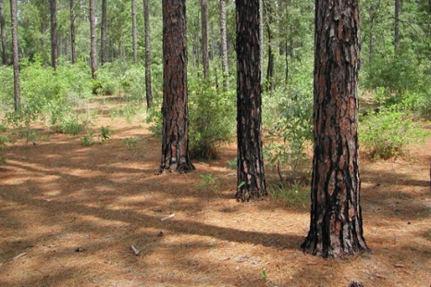
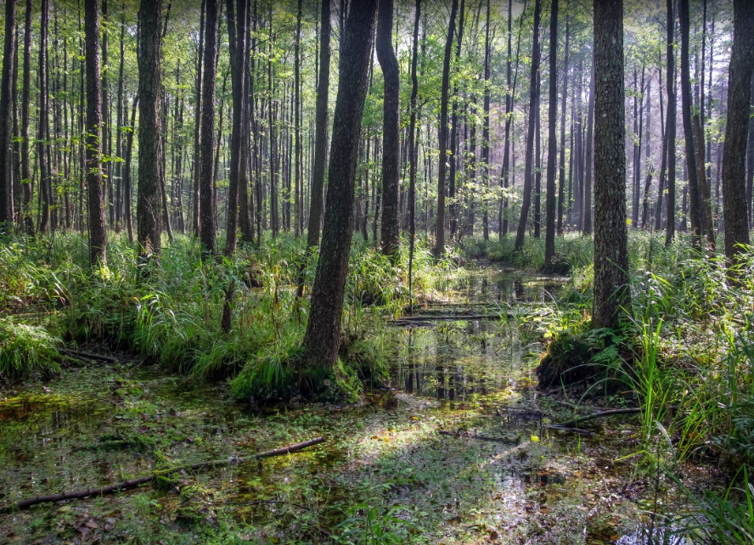
Seasonal Operability - Challenges
Currently, in the Provincial forest resource inventory (eFRI) in ON, there is generally a single attribute which can provide an indication of the best season for harvest – Ecosite Code.
Ecosite Code is based on a variety of indicators such as substrate type, soil moisture and forest cover type, and is assigned by photo interpreters.
Verification of the ecosite code for each stand in the eFRI requires considerable resources. For tenure holders, assigning someone to this task takes up a lot of time (especially in areas that are heavily reliant on winter harvest areas).
This issue is regularly faced by AV Terrace Bay, specifically in the Nipigon and Wawa administrative districts.
Vs

Slide 4
Seasonal Operability – Challenges
One of the biggest challenges faced by AV Terrace Bay when harvesting timber is the ability to maintain year-round uninterrupted operations due to the seasonal imbalance of operable areas.
Nipigon and Wawa administrative districts in ON have traditionally been heavily reliant on winter operable land base.
The issue has become critical in recent years due to shorter winter operating seasons – forest roads typically cannot begin until later in winter months and spring thaw is happening sooner – creating a short time-frame to access winter allocations.
Harvesting operations must move to upland sites earlier than anticipated due to early spring thaw.
Operability issues such as this cause problems with year-round flow of fiber.

Slide 5
Project Description
Develop an automated geoprocessing toolset to support the seasonal scheduling of forest operations.
Reduce the effort associated with field verification when making decisions on seasonal scheduling.
Enable the project partner (AV Terrace Bay) and other tenure holders to get a better indication of the best potential season for harvesting at the stand-level.
Utilize readily available existing geospatial datasets to produce an automated predictor tool.
eFRI (i.e. ecosite k06, k09,k10)
CDEM
PDEM
NOEGTS

Slide 6
Methods
Work with AV Terrace Bay to define the issue and get examples of how it impacts operational planning.
Identify the most suitable variables for predicting seasonal operability.
Site moisture, slope position, soil type, etc.
Identify a suitable study area within the Lake Nipigon Forest Unit.
Assemble the geospatial data necessary for analysis.
Develop toolbox (.tbx) within ArcGIS environment for versatility and compatibility.
Audit the toolset outputs utilizing stereo imagery and the base eFRI.

Slide 7
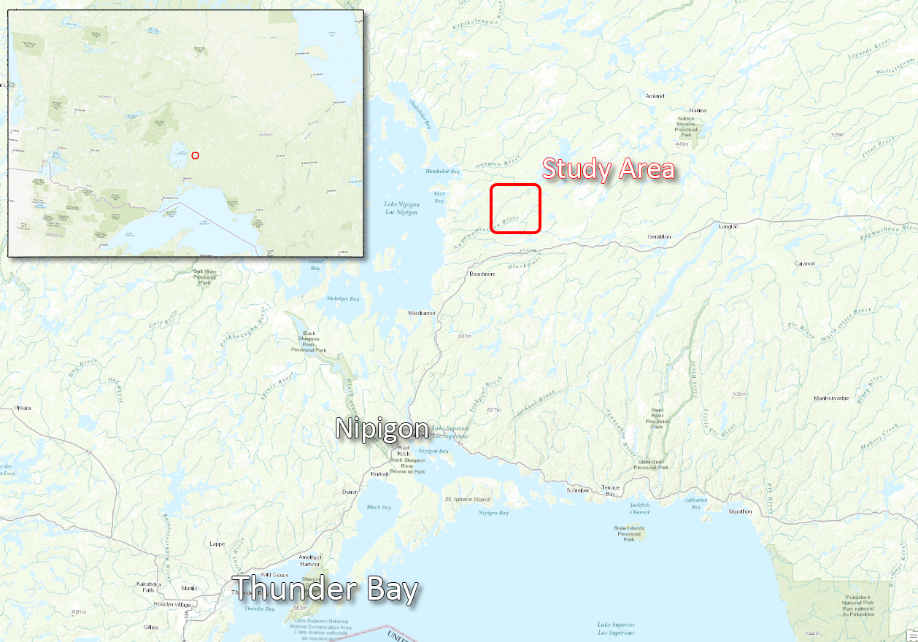

Slide 8
Geoprocessing Toolset
Uses OBM feature class or shapefile as input
Iterates through each polygon, performing analysis on ecosite and other attributes
Runs within ArcGIS Desktop 10.1 or greater
Requires Spatial Analyst extension
Easily installed within ArcMap
User guide created for installation and runtime execution.

Slide 9
Challenges, Opportunities and Next Steps
Challenged with the availability of high-quality DEM data.
Coarse resolution elevation data limits the ability to perform accurate analysis in lowland areas.
The tool was designed to utilize better elevation data where available (e.g. LiDAR), without significant recalibration of model components.
The tool relies heavily on eFRI as the primary input – eFRI does not typically capture small scale details such as isolated lowlands and wet areas.
Availability of LiDAR across Ontario licenses will enhance the output significantly moving forward.
Recommend placing more emphasis (weight) on high-resolution elevation data, and a decreased emphasis on eFRI to produce more accurate results.
Next step is to acquire LiDAR data and to test the results of the seasonal operability tool.

Slide 10
THANK YOU
www.resourceinnvations.ca
Check out our social media pages
Follow Us!

