Slide 1
Ontario Growth & Yield
Status and Needs
Final Report
June 2019
Notes:
Welcome and thank you for your time today.
I’m Margaret Penner and Doug Pitt and I have been involved in this project for over a year
We’re really pleased to be presenting the final report and especially please to be able to do it in person. Thank you.

Slide 2
Objective of Project
To identify the growth and yield needs to serve sustainable forest management for the next 20 years and beyond.
Notes:
The objective of this project is to look at growth and yield in Ontario and identify the forest management needs for the coming decade and beyond.
The Forestry Futures Trust Committee approached us to take on this project – not because they wanted our opinions on the G&Y needs. They approached us to survey government and industry to get their list of growth & yield needs.
This was prompted by a request to the Trust from industry for support to address G&Y data collection concerns. The Trust mandate does include the FRI but not G&Y. But the Trust was aware of the need for linkages between the FRI and G&Y. They were also aware of some level of frustration with the current linkages. The Trust and MNRFs FRI section decided to fund this project.

Slide 3
Methods
Held 4 workshops across the province, inviting MNRF, SFLs and academics together to identify the growth and yield needs to serve sustainable forest management for the next 20 years and beyond.
Strengths - What is working?
Weaknesses - What is not working?
Opportunities – What emerging issues are expected to affect G&Y?
Threats – What are potential barriers to an effective G&Y program?
Notes:
The objective was to solicit input from government and MNRF so four workshop were held around the province. MNRF, Industry, academics, consultants and retirees were invited and participated.
We worked with MNRF and provided background material on the current state of G&Y in Ontario prior to the workshop. As well, we included information on the FRI, IMF and planning and where they were potentially going. And each workshop started off with verbal summaries of G&Y, FRI, IMF and planning. We had great cooperation from MNRF in spite of the constraints.
At each workshop we went through the strengths of the program, the weaknesses, opportunities and threats.
We had about 130 workshop participants as well as written input. A draft report was circulated within the MNRF. Following revision, the report was circulated to the workshop participants and a final report prepared.

Slide 4
Results
G&Y and the FRI are essential parts of forest management
G&Y tools work well for the conditions they were developed for – natural-origin, uniform conifer. These conditions are a shrinking part of wood supply
Opportunity - Forests are changing, FRI is changing, climate is changing, planning process is changing
We need G&Y to model and monitor
  Cannot demonstrate sustainable management
  Cannot demonstrate sustainable harvest levels
Funding needs to match expectations
Notes:
Today we want to give you a summary of the results. And here they are.
Forest management starts with knowing what you have (inventory) and how that resource will develop under different scenarios (G&Y). And G&Y and inventory need to be completely integrated. G&Y in support of forest management includes modelling as well as monitoring.
Modelling - Sustainable forest management requires models to project change into the future. Modelling requires long term permanent field plots covering a range of conditions. These conditions include past, current and future silviculture as well as what is anticipated to happen in the absence of management. The plots should also be linked to climate variables. Modelling plot networks are used to calibrate models. And they are intentionally located in conditions of interest
Monitoring - Demonstrating sustainable management requires monitoring. Monitoring plots need to sample the population of interest with known sampling probabilities. Monitoring networks are used to compared expected change in a population to actual change. Monitoring plot networks need to sample the population with known probabilities – generally a grid sample or a random sample.
G&Y has significant assets. These include a dataset of permanent growth plots as well as tools developed from this dataset as well as others. The tools work well for the conditions they were developed for – natural-origin, pure conifer conditions. These conditions are a shrinking part of the wood supply.
Change is occurring and with change comes opportunity. Technology is allowing better and more detailed inventory. This means we can do more detailed planning. The climate is changing so we need to plan for resilience but also use adaptive management and monitoring. There are opportunities for forests to provide non-timber benefits.
We don’t have quantitative estimates of how good the FRI and G&Y are. And we don’t know well the actual outcomes match the planned outcomes (monitoring).
People at the workshops did not dwell on whether people were doing a good job or not. They weren’t questioning whether resources were being spent efficiently. They weren’t questioning whether the results were the best we can do. The real question is – are the tools good enough? Is the information good enough for a company to justify an investment? Are we fulfilling the mandate of forest management? Does funding match that mandate?
Those were the main results. Now for the details

Slide 5
And now for the details
Current State – What is working well? What is not working well?
Emerging Issues - What are the emerging issues? What is needed to address them?
Barriers - What are the barriers?
Future - What are the next steps?
Notes:
We’ll go briefly through what is working well, emerging issues, barriers and next steps.

Slide 6
Current State – legal obligation
The Crown Forest Sustainability Act (1995) regulates forest planning, information, operations, licensing, trust funds, processing facilities, remedies & enforcement and transitional provisions.
Forest Management Planning Manual (FMPM)
Forest Information Manual (FIM)
Forest Operations and Silviculture Manual (FOSM)
Scaling Manual (SM)
Notes:
Just a bit of how growth and yield fits into the broader context of forestry and forest management.
Forest management on Crown lands is regulated through manuals with the goal of managing forests to meet social, economic and environmental needs of present and future generations.

Slide 7
Planning Cycle
Determination of sustainability - Modelling
Implement
AWS
Monitor
Annual reports
IFAs
Report + Evaluate
5-year & final reports
Develop
FMP
Determination of sustainability - Monitoring
Notes:
Adaptive management cycle
Two aspects that really link to G&Y and these relate to the two checkpoints on the determination of sustainability
The first check on sustainability is modelling - the traditional focus of G&Y. Need to know what is there and how it is developing
G&Y has to be compatible with forest estate models (SFMM, Woodstock, Patchworks)
G&Y has to be compatible with the FRI
The second check on sustainability is monitoring - relatively recent (at least, the formal check is relatively recent)
G&Y has to be compatible with monitoring – early assessments and performance surveys
Plot networks for modeling and monitoring are generally quite different – the plots themselves may be identical but a plot network for modeling generally targets specific conditions of interest such as a productivity gradient.. A plot network for monitoring generally involves a grid sample or a random sample – something like the National Forest Inventory (NFI).
FMPs need to be comprehensive spatially (the entire forest) and temporally (160 years)

Slide 8
Current Past state (~20-year cycle)
Photo Interp.
Stands; spp., age, ht, stocking, ecosite
SFMM;
Aspatial;
Coarse detail, if any.
Other values
Stand vol.
Forecast stratum G&Y
Solve
Strategic Plan
Inventory
MIST
Operations
Notes:
Lets look at our current process, some parts of which have already changed. The T1 round of inventories included information on two-layer stands.
The planning process starts with an inventory which then gets run through MIST (Modelling Inventory & Support Tool) to develop yield curves at the forest unit level. These are fed into SFMM along with all the management objectives and constraints and used to develop a long term management direction. There is opportunity for input and consultation throughout the process.

Slide 9
G&Y components in the planning process
Stocking
Ecosite
site class
FU
Volume
Forecast stratum G&Y
Succession
Inventory
MIST
SFMM
Operations
Notes:
Where is G&Y? G&Y dominates the MIST portion. However, G&Y products include stocking, site class (site index), taper models for volume, ecosite and more.
Message – G&Y + FRI drive FMPs. They are the foundation.

Slide 10
Uncertainty in the planning process
Inventory
MIST
Planning
Operations
Cumulative Error
Error
+
Error
+
Error
Notes:
Message – There are sources of error
There are errors in the inventory attributes and in the field program.
There are errors associated with projecting the inventory to the base year
There are errors in the G&Y models including SI models, cull models, etc.
There are errors in the planning models, introduced by simplifying, aggregating and making assumptions about operability, piece size and quality (value)
These all lead to errors and uncertainties in wood supply.
Harvest utilization varies with markets
The end result is that actual harvested volumes are different from the predicted harvest volumes.
These error or differences are not solely due to errors in yield curves (or FRI)
Message – none of these errors are quantified and the overall error is unknown.

Slide 11
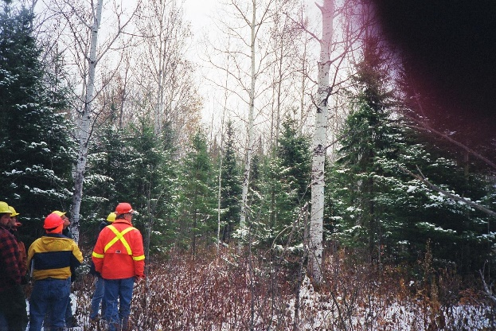

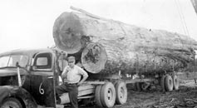
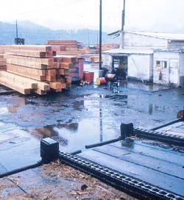
Po₁₀
82-1-18
0.8
Notes:
Another view of the same thing.
The forest resource is summarized in the inventory. With error.
Yield curves give an estimate of volumes. With error
The extracted volumes are not necessarily the standing volume (retention trees, harvest block is a subset of inventory polygon)
What gets to the mill may be different yet
And the final product volumes depend on piece size and utilization – good estimates from an FRI string?

Slide 12
How does the system work?
Inventory
MIST
SFMM
Operations
Notes:
Back to the planning process. It seems like a logical, sequential system with a beginning and end. Where does the responsibility for the each piece occur within the MNRF?
Where is G&Y involved?

Slide 13
Provincial Services Division
Science & Research Branch
FRMS Research
Model development
CNFER
Research Model development
SMBMS
IMF
BAMS
G&Y field program
NRIS
FRI
inventory
NRI
Information management
Notes:
Within the Science & Research branch, G&Y is everywhere (red bits).
BAMS collects field data which is managed by NRI and used by CNFER
The FRI also collects field data that, in general, has not been used by G&Y
The FRI is going through a big development
FRMS and CNFER do research
IMF is the new kid on the block and is reaching out to the rest of the organization
Communication and coordination is challenging.
FRMS - Forest Research and Monitoring Section
CNFER - Centre for Northern Forest Ecosystem Research
SMBMS – Strategic Management and Business Management Section
BAMS - Biodiversity & Monitoring Section
NRIS – Natural Resources Information Section

Slide 14
Provincial Services Division
Policy Division
Science & Research Branch
Crown Forests & Lands Policy Branch
FRMS Research
Model development
CNFER
Research Model development
SMBMS
IMF
BAMS
G&Y field program
NRIS
Forest Sustainability & Information
Maintaining MIST
SFMM
Forest Guides & Silviculture Section
Regen standards
Guides
FRI
inventory
NRI
Information management
Notes:
Policy division is responsible for maintaining tools (MIST & SFMM)
It’s also responsible for the regen standards (which need to link to G&Y) and the guides
Communication and coordination are even more challenging.

Slide 15
Provincial Services Division
Policy Division
Regional Operations Division
training
Science & Research Branch
Crown Forests & Lands Policy Branch
FRMS Research
Model development
CNFER
Research Model development
SMBMS
IMF
BAMS
G&Y field program
NRIS
Forest Sustainability & Information
Maintaining MIST
SFMM
Forest Guides & Silviculture Section
Regen standards
Guides
FRI
inventory
NRI
Information management
Notes:
And training falls under ROD
The common reporting entity is the Minister’s office
Each program may be doing an excellent job internally but if one piece doesn’t fit in well, the system doesn’t work.
Change in one program or tool affects everything.
If the FRI changes from polygons to rasters, this affect SFMM & regen standards
If planning goes spatial, this affects succession models
If training is absent, everything goes off the rails
Message
Not enough to function well within a silo – need functioning culverts
Requires coordination
The dispersed functions mean no one is accountable and there are gaps
Who signs off on G&Y curves in an FMP?
Who is responsible for monitoring?
Who is responsible for comparing harvested volumes to plan volumes? What happens if they don’t match?
Message
At each workshop, we started with an overview of the G&Y, FRI, IMF and policy/planning programs. MNRF participants commented that this was the first they had heard some of the details of changes within their own programs and within other programs.
The workshops were the first time they had met together in a long, long time.

Slide 16
Provincial Services Division
Policy Division
Regional Operations Division
training
Science & Research Branch
Crown Forests & Lands Policy Branch
FRMS Research
Model development
CNFER
Research Model development
SMBMS
IMF
BAMS
G&Y field program
NRIS
Forest Sustainability & Information
Maintaining MIST
SFMM
Forest Guides & Silviculture Section
Regen standards
Guides
Industry?
FRI
inventory
NRI
Information management
Notes:
Message
The SFLs echoed the MNRF comments – this was the first time they had met in a long, long time.
The SFLs have no idea what the G&Y program is up to (and that also applies to the FRI, IMF and planning)
Where is the involvement and communication with industry?
Are the strategic level results from the FRI and G&Y sufficient for industry to make investment decisions?
What happens if an SFL questions SFMM results?

Slide 17
Current State - Is the status-quo enough?
Inventory
LiDAR
Raster
CFI
growth
Carbon
Climate change
< natural-origin
> harvest-origin
Planning
Spatial
Values
Changing disturbances
Operations
Piece size
value
MIST
Tools work for pure conifer conditions and strategic, aspatial modeling…
Notes:
That is the current state. Are things okay?
Tools work well for what they were designed for – pure conifer, strategic planning.
This condition is becoming a smaller and smaller part of the wood supply.
More is coming from stands with a mixture of species, ages and sizes., more is coming from harvest origin stands
The FRI is changing to a continuous, LiDAR-derived inventor
G&Y tools will be needed to grow the inventory, to give estimates of carbon, to support climate change policy
Disturbances are changing including introduced insects & diseases
G&Y is not linked to early assessments
Succession tools don’t cover all conditions
Planning is moving toward spatial modeling – potentially requiring stand level (rather than forest unit level) tools for yield, growth & succession
Planning considers other values include habitat
Indications that piece size is changing which has implications for value
Message – The status-quo is not enough. all the pieces are all changing. This is a tremendous opportunity

Slide 18
Emerging Issues
What is needed?
Communication & integration
Plot network
  Modelling
  Monitoring
Accountability
Notes:
There was a general feeling that people don’t know what is going on.
There is nostalgia for the Forest Ecosystem Science Co-op and the Forestry Research Partnership because of the communication that occurred.
What is going on in other programs especially with the new inventory? What is IMF? What about early assessments
The plot network needs attention now
The fragmentation of roles and responsibilities across the MNRF is resulting in gaps – who is responsible for ensuring the next round of inventory has the necessary G&Y tools?

Slide 19
Barriers
What are the barriers?
Constant change
Institutional inertia
Funding
Lack of consequences
✓ manage through communication & consultation
✗ - fix
✓ Match funding to expectations
✗ - establish accountability
Is it the best we can do?
Is good enough?
Notes:
The constant change means it will always be interesting. The change is spatial and temporal. And the effects are long term. Decisions and actions will have long term consequences. We can’t stop change – we need to work with it. SFLs understand the need for change. Anticipating change is critical and that involves communication and consultation.
Then there is institutional inertial It is difficult to change. In a draft of our report, we suggested resurrecting the position of chief forester – someone who would be accountable. This was roundly trashed by everyone (SFLs & government) – partly because any change would temporarily paralyze everything and partly because there was consensus that decisions made locally would be better. Need to improve communication and accountability
Funding – match funding to expectations. Some technological solutions and examples from other jurisdictions
Will anyone notice if nothing changes? Currently there are no checks on forest management, no assessment of whether planned operations were carried out and no assessment f whether anticipated (projected) changes occurred. The impacts of doing nothing will be felt 5 – 10 years from now when the costs and time-lag associated with restarting the G&Y program will be daunting. Like climate change, doing nothing is a tempting short-term “action” that will undoubtedly be followed by disastrous long-term consequences that will be expensive to deal with.
Doing nothing puts Ontario’s $15 billion forest sector at risk.
The question is not whether we are doing the best we can do but whether it is good enough!

Slide 20
Next Steps
What are the next steps?
Identify core business and identify roles, responsibilities and accountabilities.
  Maintain plot network in the new forest, especially repeated measurements to project change (growth)
  Maintain and develop G&Y tools (including training and integration with other programs)
Fund core business.
Ensure coordination, particularly with FRI.
Communicate
Notes:
What is needed and who should do it? Forest management requires knowledge of the resource (inventory) and how it is changing (G&Y). Make one person accountable for each part and give them the tools.
Quantitative data and tools with known reliability or confidence
Deal with succession planning and the significant number of vacant positions, people in acting positions and mobility. Can someone in an acting position or someone new to a position be accountable?
Fund the core business or revise the core business
FRI & G&Y are the basis of forest management. They need to be coordinated with all program – planning, guides, policy, research, etc.
Communicate and, where possible, consult throughout the process
This is not a well-defined problem with an analytic or engineering solution – this is a poorly defined problem with many unknowns (from trade barriers to introduced pests and diseases), many estimates (from utility prices to the forest inventory) and many parts that are changing (from climate to research & technology)

Slide 21
Recommendations
Look at the forest management planning process.
  RACI model
  Develop an error budget and find out where large errors occur and evaluate the cost of doing nothing
Understand role of G&Y moving forward; join FRI and G&Y and include G&Y in the mandate of the FFT.
Communicate.
Look at New Brunswick’s inventory/G&Y program (LiDAR-based FRI and CLI) as an example.
Notes:
FMPM calls for identification of a forest analysis and modeling task team. The FMPM says the “Components (e.g., models or analysis tools) of the decision support system to be used for any of the following tasks will be approved by the director of MNRF’s Crown Forests and Lands Policy Branch prior to inclusion in the terms of reference”. This is Marty Blake. These tools must apply to the entire forested and non-forested landbase and project the forested landbase for 160 years.
The T2 round of inventory requires new products from G&Y including volumes and inventory update models. The inventory will not be prepared and then handed off to G&Y, G&Y tools are required to provide the inventory. G&Y is embedded in the inventory.
Communicate throughout the process. The FRI update at the workshops was huge and well received. People don’t know what is going on or who to ask. Documentation exists but is not communicated.
Look at other jurisdictions

Slide 22
Recommendations – RACI model
 | FRI Group | FRI Manager | G&Y Group | Regional G&Y Specialist | LCC | Regional Analyst | Monitoring
FRI | R | A | C | C | I
SFU | R |  | R | A |  | C
Yield Curves |  |  | R | A | I | C
FMP objectives |  |  |  |  | R | A
Monitoring
R – Responsible – who does the work?
A – accountable – who gives final approval? Only one accountable person
C – Consulted – subject matter experts (two-way communication)
I – informed – who is kept up to date on progress (one-way communication)

Slide 23
Current Past state (~20-year cycle)
Photo Interp.
Stands; spp., age, ht, stocking, ecosite
SFMM;
Aspatial;
Coarse detail, if any.
Stand vol.
Forecast stratum G&Y
Solve
Strategic Plan
Inventory
MIST
Operations
System is self-compensating (but not self-refining).
Huge leap from strategic plan to operational implementation = growing discomfort.
Strategic information on volume and piece size, but more is wanted.
Disconnect between inventory variables and variables used in G&Y models (e.g., stocking, ecosite vs. BA, SI); two programs aren’t strongly linked; FRI is evolving.
Portion of the forest being adequately forecasted is diminishing.
Notes:
In my mind, the big thing that will/must precipitate change for G&Y is the next round of FRI. That’s the crisis for G&Y. That’s what is going to drive us to change. I think it may also be precipitated by legal challenges – the MNRF has a legal responsibility for sustainable management – the forests for which we have G&Y tools are a shrinking part of the landbase – even if the FRI remains the same, we need more tools.
I want to describe how this new round of inventory is going to drive change for G&Y, but first, lets just review our current process. But since we’re already at a turning point, lets call it our past process.
Our previous FRI was based on photo-interpretation; the delineation of stands or polygons of similar species composition, age, height, stocking, and ecosite. MIST is a software shell that incorporates many G&Y products (empirical yield curves, SI equations, taper models and cull estimates) – it is used to assign volumes to the FRI stands and forecast stratum-level yields for management planning. Strategic forest management planning is done through constraint-based modeling in SFMM, and then managers have to locate the values on the ground, translating the 20-year strategic plan into tactical and operational plans.
The process is self compensating in the sense that if there ends up being less and less value at the front end, planning will adjust to try and make things sustainable. But there are no feedback loops to validate any of the steps in this process (the inventory, the G&Y, the planning) – nothing as simple as “did we cut what we thought was there?”.
The very large leap from the aspatial strategic plan to the tactical and operational pieces is making folks increasingly uncomfortable – they need information to understand where the values are. They’re crying for more stand-level detail on volume, piece size.
There currently is not a smooth link between the inventory and G&Y – stocking and ecosite are nice, but G&Y uses BA and site index. The two aren’t working together.
And finally, the part of the forest that we’re modeling well is becoming smaller and smaller piece of the pie. Partial cuts, variable retention, a huge array of silviculture are resulting in stands that look nothing like the original forest.
So by looking at our past state, we just summarized much of the workshop feedback…

Slide 24
Recommendations – understanding where G&Y fits moving forward
LiDAR +;
20x20m grid cells;
spp., ht, QMD, BA, Vol.
Plot library;
Match = Tree-list inventory;
Tree-list growth.
Spatial;
Full operational detail available.
Tree-list inventory and growth
Solve
Strategic Plan
Spatial Operations
Inventory
Better congruency = increased opportunity to refine/improve/adapt.
Fluid transition from strategic to tactical and operational detail.
Accurate spatial estimates of volume and piece size.
Huge benefits of DTM – prime site identification, roads, environmental, lower costs…
Direct connect between inventory and growth (= strong linkage between two programs).
Tree-list approach works in any type of forest being created.
Notes:
So what now? What does our new process look like? Where does G&Y fit into this new era?
Now, our inventory, should the province embark on such, will be LiDAR derived. We will have predictions of height, BA, QMD, volume, and %hardwood on a 20-m x 20-m grid, wall-to-wall. These estimates will be generated based on relationships between LiDAR point cloud statistics and what we measure on the ground and so G&Y will play a role in the calibration of the LiDAR inventory.
Estimates for stands, or any area of interest will be derived by aggregating the grid cell estimates in those areas. This will give us a very good handle on what is there at time 0, but we’ll quickly need to move that inventory through time. This is where G&Y plays an integral role in making this LiDAR snapshot a continuous inventory. G&Y will provide us with the plot library that we use to match actual tree lists to LiDAR grid cells (I’ll illustrate this in more detail in a moment) AND then the growth information to calibrate tree-list growth models that grow the inventory through time and make the forecasts needed for management planning.
Forest management planning is done, given all the same constraints dealt with in the past, but the plans will be scalable from strategic though operational because the building blocks are the 20x20 grid cells and the tree lists that each carries.
Now there’s nice congruency in the system so that feedback loops not only self adjust, but validate the individual steps in the process.
The product is scalable, providing spatial detail on piece size, volume, and value.
A huge side benefit of the LiDAR is the detailed and accurate DTM that enhances prime-site identification, reduces road costs, and enhances the environmental integrity of our footprint.
There is a direct and seamless linkage between Inventory and G&Y.
And, the tree–list approach accommodates any of the complexity we’re creating in the “new” forest.
So to illustrate the important role that G&Y might play in this new state, or process, I’d like to look at NB as an example…

Slide 25
Recommendations - A look at NB as a model…
Very similar past programs 1980-2014:
Photo-based stand polygon interp.
Some timber cruising to support photo-interp.
~3500 PSPs
Stratification, with G&Y forecasting by strata.
Similar user-discontent…
Notes:
They’re a smaller province, about 1/11th the size of ON, but their inventory/G&Y histories are similar and they’re a few years ahead, so I think we can learn something from their experience. Until about 2014, their system was much we’ve described a few slides ago…

Slide 26
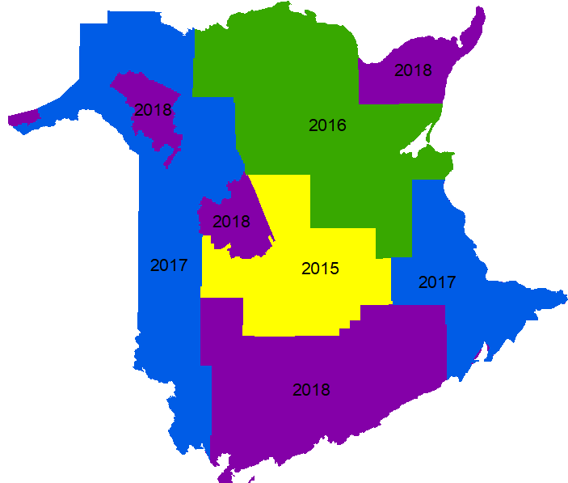
Transition to LiDAR
2015 transition to LiDAR:
WTW predictions on a 20-m grid:
Volume
BA
QMD
Top Height
% hardwood
Species Comp. still drawn from photo-interp, but…
Hennigar et al. 2019, NB-DERD
Notes:
In 2015, the province embarked on acquiring WTW LiDAR coverage – ironically, after looking at the research that we did right here on ON on the RMF! They were one of the early adopters and now have wall-to-wall LiDAR coverage throughout the province. So each of the province’s 150 million grid cells has volume, BA, THT, QMD, and % hardwood among other variables. Species is still derived from photo-interp, but this is changing rapidly, as new work with multi-scene Sentinel imagery appears to be close to cracking the species nut…

Slide 27
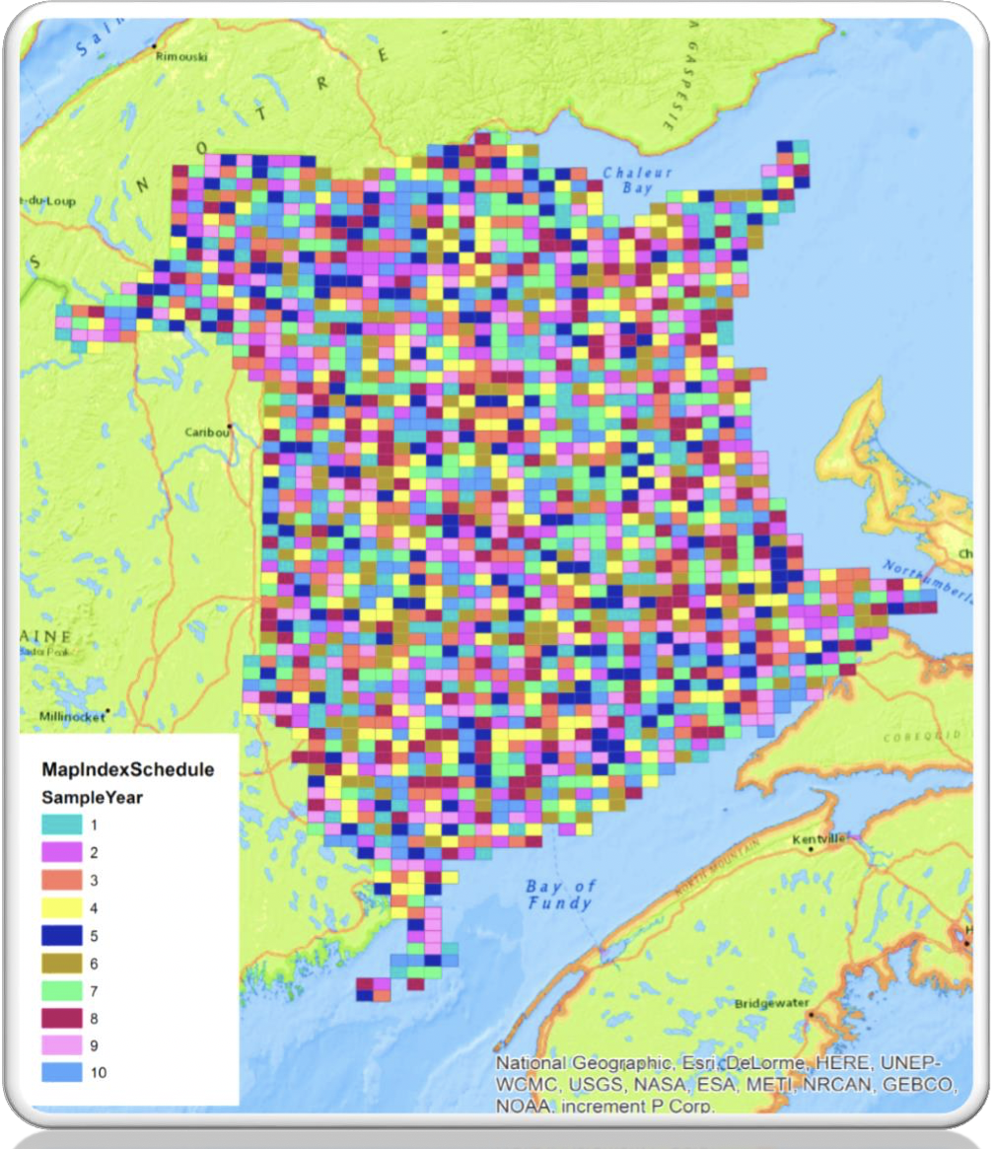
Continuous Land Inventory
2015 transition to CLI:
2-km grid of 400 m² plots on 10-year cycle (15000 plots)
Subset on the 4-km grid = tagged trees and 5-year cycle (3750 plots).
Purpose:
Unbiased inventory and change estimates (monitoring).
Calibration of LiDAR (modelling).
Calibration of tree-list growth model (OSM) (modelling).
Data source for plot-matching (library).
Hennigar et al. 2019, NB-DERD
Notes:
Along with this shift to LiDAR was a shift on the G&Y side moving away from the 3500 odd PSPs previously to a continuous land inventory. 400-m² plots are located on a systematic 2-km grid, with ¼ of these plots fully monumented and measured on a 5-year cycle.
This plot network serves 4 main purposes:…

Slide 28
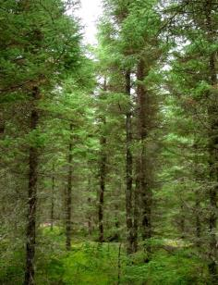
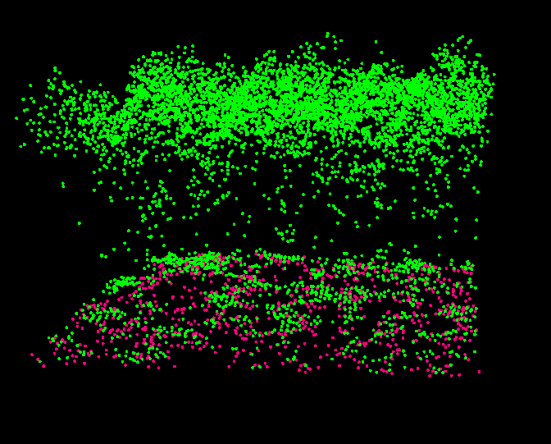
Individual-tree, continuous inventory through plot matching
Plot matching: Translate LiDAR 20-m grid metrics to an individual tree inventory...
GTV, BA, QMD, tHT, %Hardwood, Species Comp.
Grid cell assumes full tree-list attributes for plot 2368
Tree-list model (FVS or OSM) “grows” plot 2368
RandomForests, K-NN, k=1
Plot 2368
M. Woods
D. Pitt
20x20-m grid cell
Plot w. matching attributes
LiDAR metrics @ t₀
Tree-list inventory @ t₀
Tree-list inventory @ t_{x}
Notes:
Now, just in closing, I want to make sure you understand this plot-matching idea and the role it plays in translating the LiDAR inventory into an individual tree inventory that is then grown through time. Understanding this is prerequisite to understanding the role that G&Y must play in this “new era”.
Everyone, I think by now, understands that LiDAR simply provides us with structural height measurements of our forest. Statistics describing these height measurements are correlated with inventory variables that we’re interested in (GTV, BA, QMD, HT). It takes a suite of ground plots to calibrate these relationships.
This inventory as a snapshot in time is fantastic. But we quickly want more… We want things like diameter distribution, volume in certain size classes, and we want to grow the inventory as it changes. G&Y provides us with a massive library of plots – tree lists from which we can generate the same metrics that we have in the LiDAR inventory. The age of the data matters not – only that it fully describe the tree list. Using randomForests or K-NN, we can match each of the grid cells to a plot in our data base (same GTV, BA, …Spp), allowing the grid cell to then assume the tree list of that plot.
So this now adds diameter distribution, piece size, etc. to our inventory, essentially making it an individual tree inventory. The next thing we want to do is grow it. Well, the tree lists are ideal for FVS or OSM to do such, provided we have the G&Y data to well-calibrate the models.
Clearly, G&Y plays a critical role in each step of this process, helping to calibrate the LiDAR grid cell predictions, serving as the library of plots for plot matching, and calibrating the tree-list growth model used to grow the inventory.
Bottom line is there is no silver bullet that gets us out of the business of measuring trees.

Slide 29
Good sources in NB:
Chris Hennigar (NB, Forus);
Adam Dick (CFS);
Sean Lamb (Forus);
Dale Wilson (NB);
David Young (JDI)
Notes:
I’ll stop there, I strongly encourage you to contact and learn from these folks out in NB…

Slide 30
Conclusions
Opportunities – FRI, IMF, existing plot network
Change – our forests, landbase, climate, disturbances
Status quo applies to a shrinking part of the landbase
Report is available
FFTC is supportive
Notes:
This is time of tremendous opportunity. When MIST was developed, development was constrained to fit with the existing FRI. All the programs are changing, removing technical constraints. The foundational pieces of management planning are the FRI and G&Y and this is an opportunity to change the game. This is not a time of maintenance. This is a time for vision not nostalgia. And with all this talk about change, one of the biggest opportunities results from the existing modeling plot network that can be used to develop some of the tools needed.
Forests grow, the climate is changing and disturbance patterns and disturbance agents are changing.
The current tools, the status quo, is applicable to a shrinking part of the landbase. More of the wood supply is coming from mixed species, complex stands under a changing climate.
The final report of this project is available from the Trust
The Trust is fully supportive

Slide 31
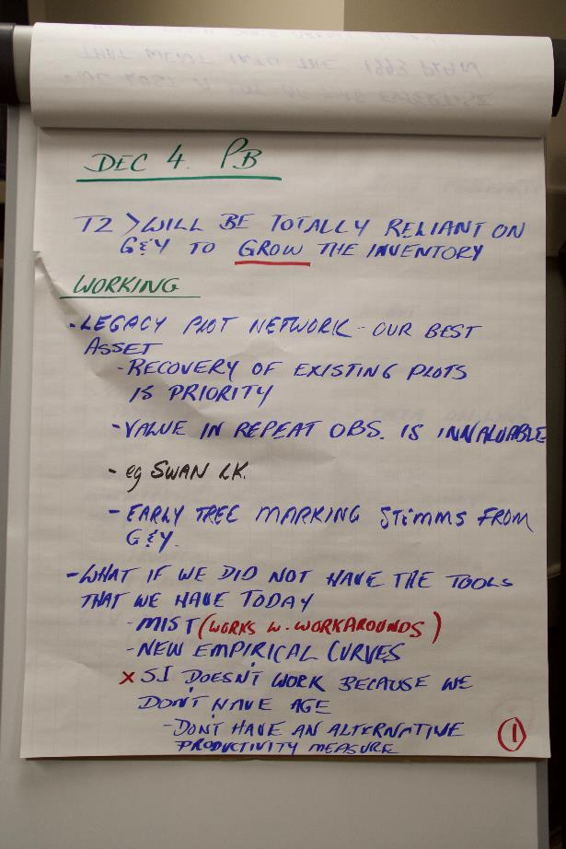
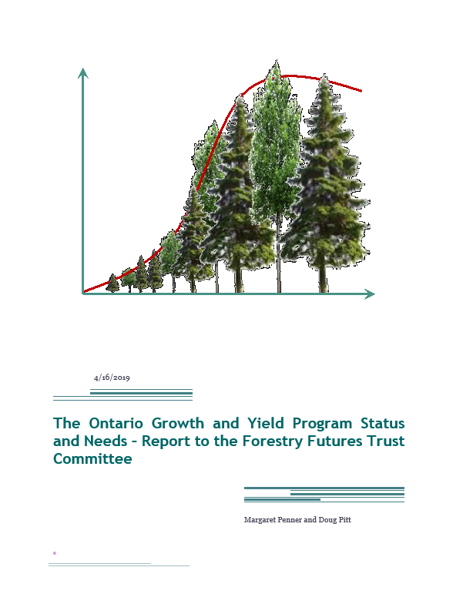
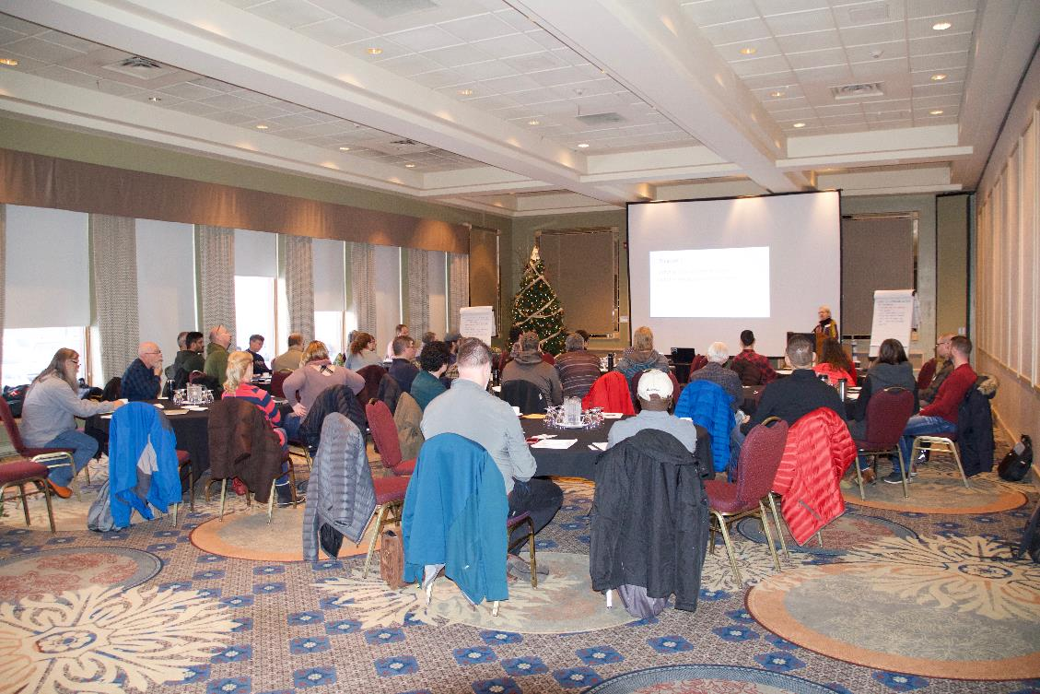
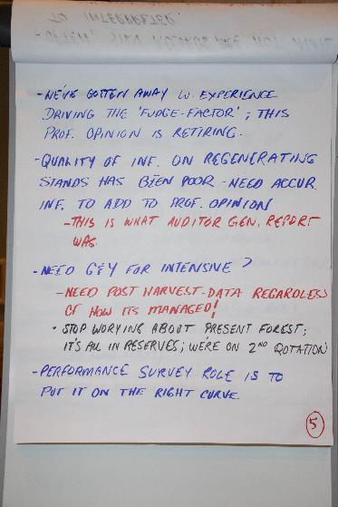
Thanks!
Notes:
Thank you for giving us your time today.
Thank you to the Trust for initiating and funding this project
And thank you to all who participated in the workshops and review.

